Slide 1
UNIT-II Building Blocks of Language

Slide 2
Introduction
Operator in java is a symbol that is used to perform operations.
Unary Operator
Arithmetic Operator
shift Operator
Relational Operator
Bitwise Operator
Logical Operator
Ternary Operator
Assignment Operator

Slide 3
Bitwise Operator
Java defines several bitwise operators, which can be applied to the integer types, long, int, short, char, and byte.
Bitwise operator works on bits and performs bit-by-bit operation.
Assume if a = 60 and b = 13;

Slide 4
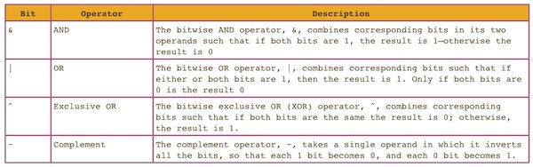
Ex: a = 0011 1100
b = 0000 1101
Then,
a&b = 0000 1100
a|b = 0011 1101
a^b = 0011 0001
~a = 1100 0011

Slide 5
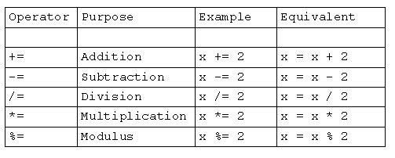
Assignment Operator
It used to assigns the value on its right to the operand on its left.
Datatype Variable = expression;
Ex: int x=5;

Slide 6
Unary Operator
The unary operators require only one operand.
They perform various operations such as incrementing/decrementing a value by one, negating an expression, or inverting the value of a Boolean.
Prefix and postfix

Slide 7
Operator | Description
+ | Unary plus operator; indicates positive value (numbers are positive without this)
- | Unary minus operator; negates an expression
++ | Increment operator; increments a value by 1
-- | Decrement operator; decrements a value by 1
! | Logical complement operator; inverts the value of a boolean

Slide 8
Logical Operators
These operators are used to perform “logical AND” and “logical OR”, “Logical NOT” operation
Similar function as AND gate and OR gate in digital electronics.
One thing to keep in mind is the second condition is not evaluated if the first one is false, i.e. it has short-circuiting effect.
Used extensively to test for several conditions for making a decision.

Slide 9
Logical Operators
&& , Logical AND :
returns true when both conditions are true.
|| , Logical OR :
returns true if at least one condition is true.
!, Logical Not:
Returns true if the value is false and vice versa.

Slide 10
Shift Operator
These operators are used to shift the bits of a number left or right thereby multiplying or dividing the number by two respectively.
They can be used when we have to multiply or divide a number by two.

Slide 11
<< , Left shift operator: shifts the bits of the number to the left and fills 0 on voids left as a result. Similar effect as of multiplying the number with some power of two.
>> , Signed Right shift operator: shifts the bits of the number to the right and fills 0 on voids left as a result. The leftmost bit depends on the sign of initial number. Similar effect as of dividing the number with some power of two.
>>> , Unsigned Right shift operator: shifts the bits of the number to the right and fills 0 on voids left as a result. The leftmost bit is set to 0.

Slide 12
Relational Operators
These operators are used to check for relations like equality, greater than, less than.
They return boolean result after the comparison and are extensively used in looping statements as well as conditional if else statements.

Slide 13
Relational Operators
== , Equal to :
returns true of left hand side is equal to right hand side.
!= , Not Equal to :
returns true of left hand side is not equal to right hand side.
< , less than :
returns true of left hand side is less than right hand side.

Slide 14
Relational Operators
<= , less than or equal to :
returns true of left hand side is less than or equal to right hand side.
> , Greater than :
returns true of left hand side is greater than right hand side.
>= , Greater than or equal to:
returns true of left hand side is greater than or equal to right hand side.

Slide 15
Ternary Operators
Ternary operator is a shorthand version of if-else statement. It has three operands and hence the name ternary.
Syntax:
expr1? expr2 : expr3
Ex: (a>b)?a:b

